Slide 1
Chapter 7: Parallel Ports
The PIC18 Microcontroller
Han-Way Huang
Minnesota State University, Mankato
June 2004

Slide 2
Introduction
Embedded products are designed to allow the user to provide input and receive results.
The speed and characteristics of I/O devices are quite different from the CPU.
Peripheral chips are used to resolve the difference between the I/O devices and the CPU.
The major function of the interface chip is to synchronize the data transfer between the CPU and I/O devices.
Resistors may be needed to limit the current flow, whereas buffer chips may be needed to increase the current flow required by the I/O devices.
An interface chip consists of control registers, data registers, status registers, data direction register, and control circuitry.
Control registers allow the user to set up operation parameters.
Data registers holds the data to be output or received.
Status register records the status of the I/O operation.
Data direction register allows the user to set the direction of data transfer.
To input, the processor reads data from the data register.
To output, the processor writes data into the data register.
The interconnection between the microprocessor, interface chips, and I/O devices are shown in Figure 7.1.

Slide 3
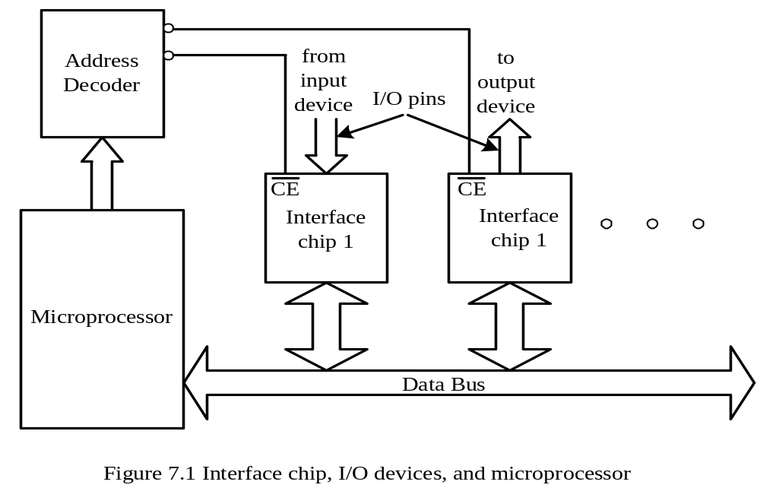
The address decoder in Figure 7.1 allows one and only one interface chip to exchange data with the microprocessor at a time.
Data transfer can be proceeded in parallel or bit by bit (serial method).
Serial method is meant to be used with slower I/O devices
Parallel method is meant to be used with high-speed devices.
This chapter focuses on parallel I/O.

Slide 4
I/O Addressing
The processor needs to access the registers of the interface chip to perform the I/O operation.
An address is needed to select the register inside the interface chip and instructions need to be executed to carry out the appropriate operations.
Two issues arise here:
1. Address space sharing
2. Instruction set and addressing modes sharing

Slide 5
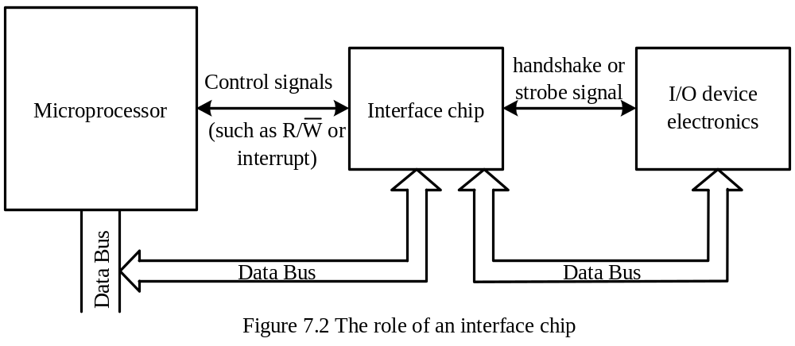
I/O Synchronization
The role of the interface chip is shown in Figure 7.2.
For input, the CPU needs to make sure it reads when the data is valid and reads only once.
For output, the CPU needs to make sure that the output device is ready to accept new data.
There are two aspects in the I/O synchronization: the synchronization between the CPU and interface chip and the synchronization between the interface chip and the I/O device.

Slide 6
Synchronization between the CPU and the Interface Chip
1. Polling method. Use a flag bit to indicate the readiness of I/O operation.
2. Interrupt-driven method. Use the interrupt signal to inform the CPU that new data is available or output device is ready for more data.
None of the PIC18 I/O ports support either method directly.

Slide 7
Synchronizing the Interface Chip with I/O Devices
1. No method
- Input: The interface returns the current value of the input pins.
- Output: The interface drives the data written by the CPU directly on output pins.
2. Strobe method
- A strobe signal is used to synchronize data transfer.
- Input: The input device places data on input pins, wait until data is stable, and then asserts the strobe signal to inform the interface chip to latch the data.
- Output: The interface chip drives data to be output on the output pins, wait until data is stable, and then asserts the strobe signal to inform the output device to latch the data.
- PIC18 does not support this method.
3. Handshake method
- Two handshake signals are used to synchronize the data transfer between the interface chip and I/O device. H1 is driven by interface chip and H2 is driven by I/O device.
- There are two versions of handshaking: pulse mode and interlock mode.
- Handshaking signals transactions for input and output are shown in Figure 7.3 and 7.4, respectively.

Slide 8
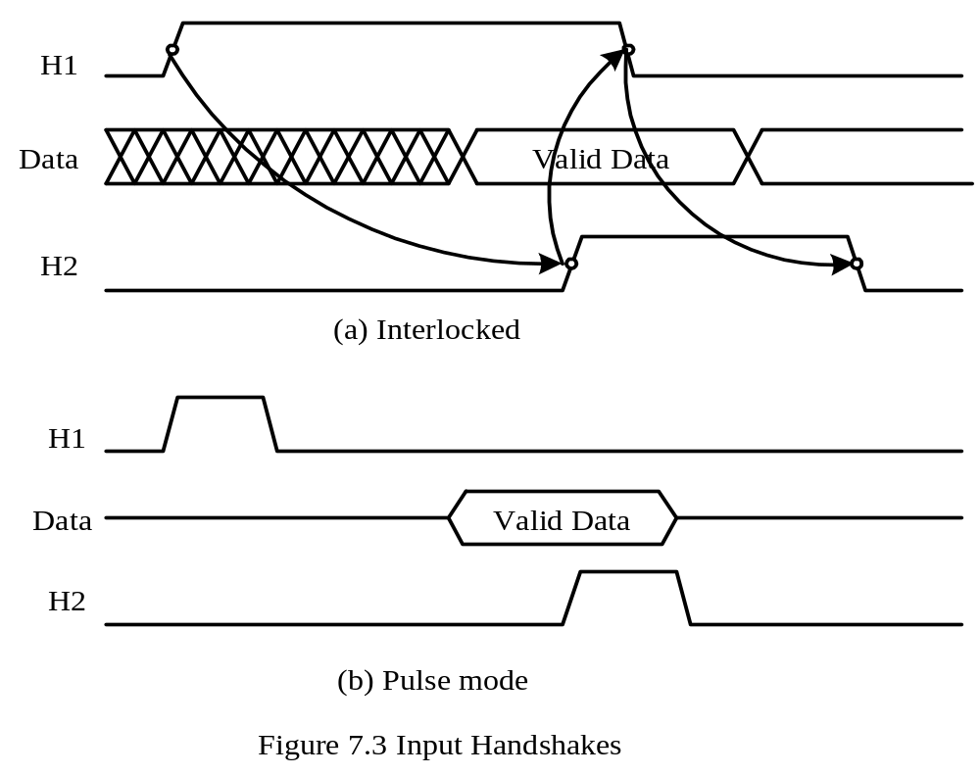

Slide 9
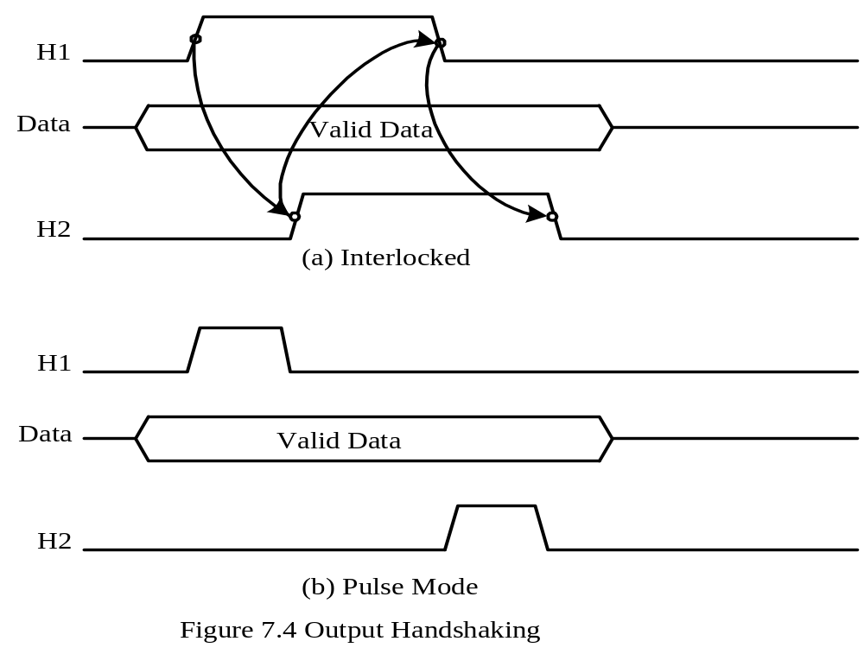

Slide 10
Overview of the PIC18 Parallel I/O Ports
I/O pins are often grouped into ports.
A port consists of up to 8 pins, a data direction register (TRISx), a latch register (LATx) , and a data register (PORTx); where, x = A…H, J, K.
Data to be output is written into the latch, which in turn drives the output pins.
A PIC18 may have as many as 10 I/O ports.
An I/O port is often multiplexed with one or more peripheral functions.
When a peripheral function is enabled, the I/O pins cannot be used for general- purpose I/O.
Devices with 18 pins and 20 pins have two I/O ports: A and B.
Devices with 28 pins have three I/O ports: A, B, and C.
Devices with 40 pins (DIP package) and 44 pins (PLCC package) have five parallel ports: A, B, C, D, and E.
Devices with 64 pins (TQFP package) and 68 pins (PLCC package) have seven ports: A, B, C, D, E, F, and G.
Most 80-pin (TQFP package) and 84-pin devices (PLCC package) have nine ports but some 84-pin devices (e.g., PIC18F858 in PLCC package) have 10 ports.
The number of pins available in each port is shown in Table 7.1.

Slide 11
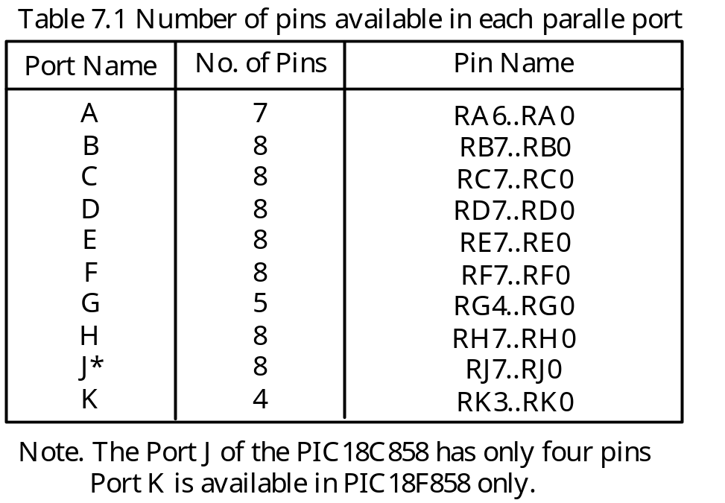

Slide 12
Reading and Writing the I/O Ports
Data direction needs to be set before the I/O operation.
To configure an I/O pin for input, set the associated bit in the TRIS register to 1.
To configure an I/O pin for output, set the associated bit in the TRIS register to 0.
Example 7.1 Write an instruction sequence to output the hex value 0x33 to port D.
Solution:
The port D should be configured for output before data is written to it.
clrf TRISD,A ; configure port D for output
movlw 0x33
movwf PORTD,A
Example 7.2 Write an instruction sequence to read the current value of port D into WREG.
Solution:
setf TRISD,A ; configure port D for input
movf PORTD,W,A ; read port D pin value into WREG

Slide 13
- Part of an I/O port pins can be configured for input whereas others are configured for output.
Example 7.3 Configure the upper four pins of port D for input and the lower four pins for output.
Solution:
movlw 0xF0
movwf TRISD,A

Slide 14
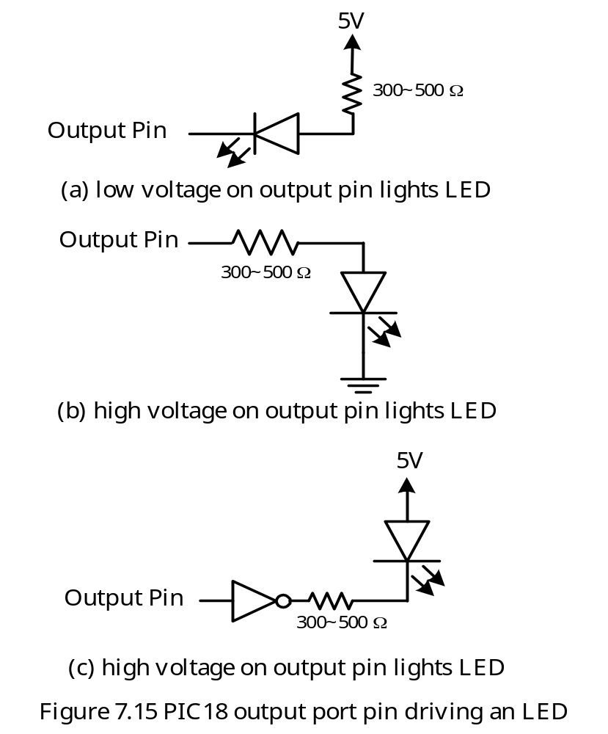
Interfacing with LEDs
Several interfacing methods are possible.
Method (a) is used in SSE demo boards
Method (c) provides some protection to the microcontroller.

Slide 15
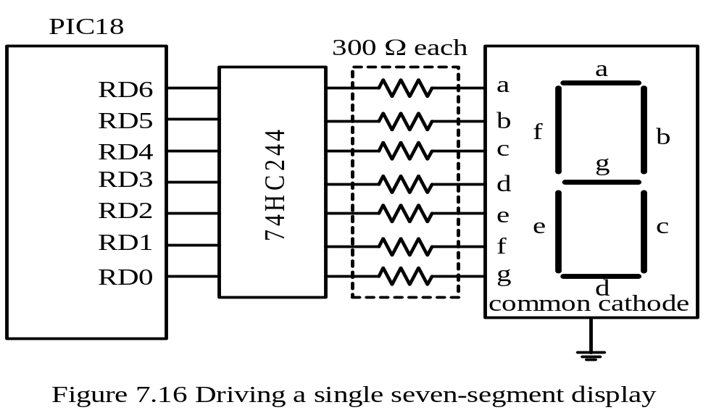
Interfacing with Seven-Segment Displays
Used to display a few decimal digits.
A buffer chip is often used to provide enough current to dive the displays.
A one-display circuit is shown in Figure 7.16.
Multiple-digit displays can be achieved by using time-multiplexing technique shown in Figure 7.17.
To display a decimal digit, appropriate pattern must be output to port D in Figure 7.16 and 7.17. These patterns are shown in Table 7.2.

Slide 16
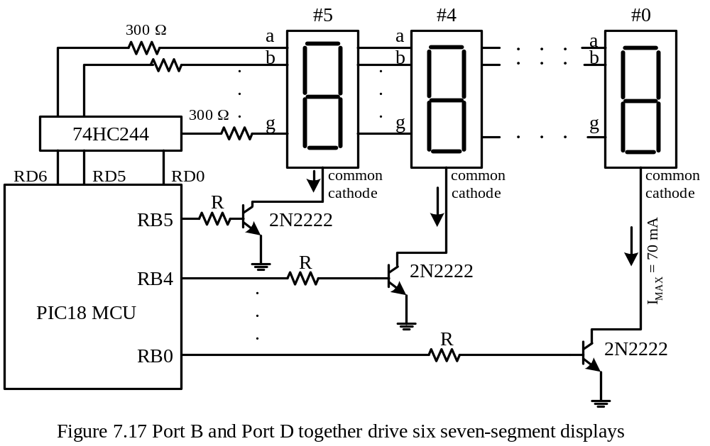

Slide 17
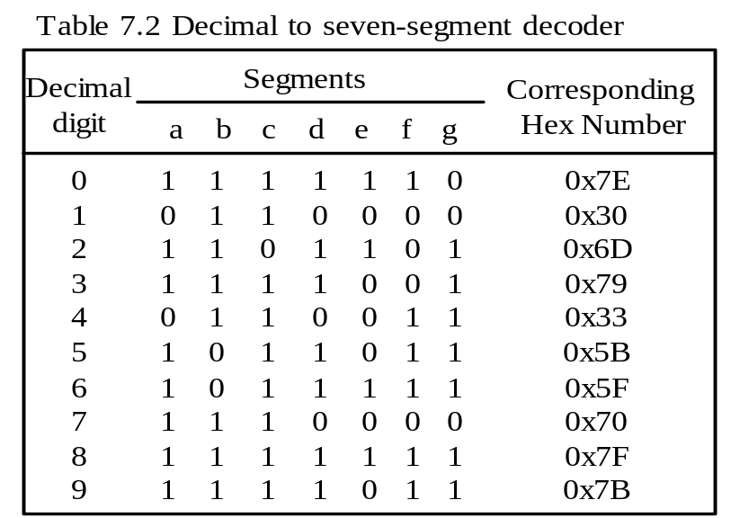
The display a decimal digit on display i, perform the following operations:
1. Configure both port B and port D for output
2. Drive RBi pin to high
3. Drive other port B pins to low
4. Output the hex value corresponding to the specified decimal digit to port D

Slide 18
Example 7.4 Write an instruction sequence to display 5 on the seven-segment display #4 in Figure 7.17.
Solution:
In assembly,
clrf TRISB,A ; configure port B for output
clrf TRISD,A ; configure port D for output
movlw 0x5B ; output the segment pattern of 5
movwf PORTD ; “
movlw 0x10 ; enable display #4 to light
movwf PORTB ; “
In C language,
TRISB = 0x00;
TRISD = 0x00;
PORTD = 0x5B;
PORTB = 0x10;

Slide 19
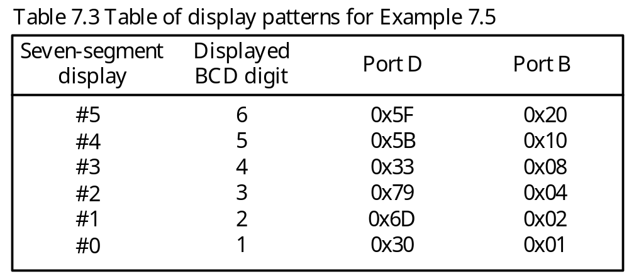
How to display multiple digit in Figure 7.17?
Light each digit in turn briefly (say, 1 ms a time) and then turned off.
When one display is lighted, all other displays are turned off.
Because of the persistence of vision, all displays will appear lighted simultaneously.
Example 7.5 Write a program to display 654321 on the six seven-segment displays in Figure 7.17 assuming that the PIC18 is running with a 32-MHz crystal oscillator.
Solution: The values to be output to port B and port D are listed in Table 7.5.

Slide 20
#include <p18F8680.inc>
radix dec
dup_nop macro kk ; this macro will duplicate the “nop” instruction
variable i ; kk times
i = 0 ; need to be at a separate line
while i < kk
nop
i += 1 ; need to be at separate line
endw
endm
lp_cnt set 0x00 ; use data memory 0 as loop count
lp_cnt1 set 0x01 ; another loop count
org 0x00
goto start
org 0x08
retfie
org 0x18
retfie
start clrf TRISB,A ; configure Port B for output
clrf TRISD,A ; configure Port D for output
forever movlw 0x06 ; there are six digits to be displayed
movwf lp_cnt ; "

Slide 21
movlw upper disp_tab
movwf TBLPTRU,A ; "
movlw high disp_tab ; "
movwf TBLPTRH,A ; "
movlw low disp_tab ; "
movwf TBLPTRL,A ; "
loop tblrd*+
movff TABLAT,PORTD ; output the seven-segment pattern
tblrd*+
movff TABLAT,PORTB ; turn on one display
call wait_ms ; wait for half a millisecond
decfsz lp_cnt,F,A ; decrement the loop count
goto loop ; read the next pattern
goto forever ; go to the start of the pattern table
end

Slide 22
************************************************************************
; The subroutine wait_ms creates a delay of 1 ms for a demo board running
; at 32 MHz crystal oscillator.
; ************************************************************************
wait_ms movlw 200
movwf lp_cnt1, A
again dup_nop 37 ; 37 instruction cycles
decfsz lp_cnt1,F,A ; 1 instruction cycle (2 when [lp_cnt1] = 0)
goto again ; 2 instruction cycles
return
disp_tab db 0x5F,0x20
db 0x5B,0x10
db 0x33,0x08
db 0x79,0x04
db 0x6D,0x02
db 0x30,0x01
end

Slide 23
#include <delays.h>
#include <p18F8680.h>
char display[6][2] = {{0x5F,0x20},{0x5BD,0x10},{0x33,0x08},{0x79,0x04},
{0x6D,0x02}, {0x30,0x01}};
void main ()
{
int i;
TRISB = 0x00; /* configure Port B for output */
TRISD = 0x00; /* configure Port D for output */
while (1) {
for (i = 0; i < 6; i++) {
PORTD = display[i][0]; /* output display pattern */
PORTB = display[i][1]; /* turn on one display */
Delay1KTCYx(8); /* wait for 1 ms */
}
}
}

Slide 24
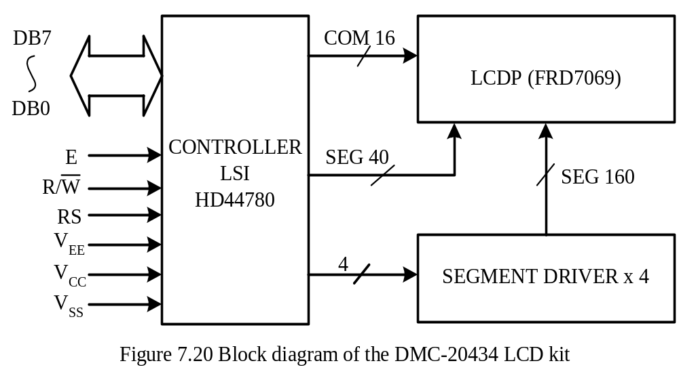
Using the LCD kits with the HD44780 LCD Controller
Can control the display of up to 80 characters in an LCD kit.
Block diagram of the HD44780 is shown in Figure 7.20.
A standard connector for the HD44780-based connection method is shown in Table 7.5.

Slide 25
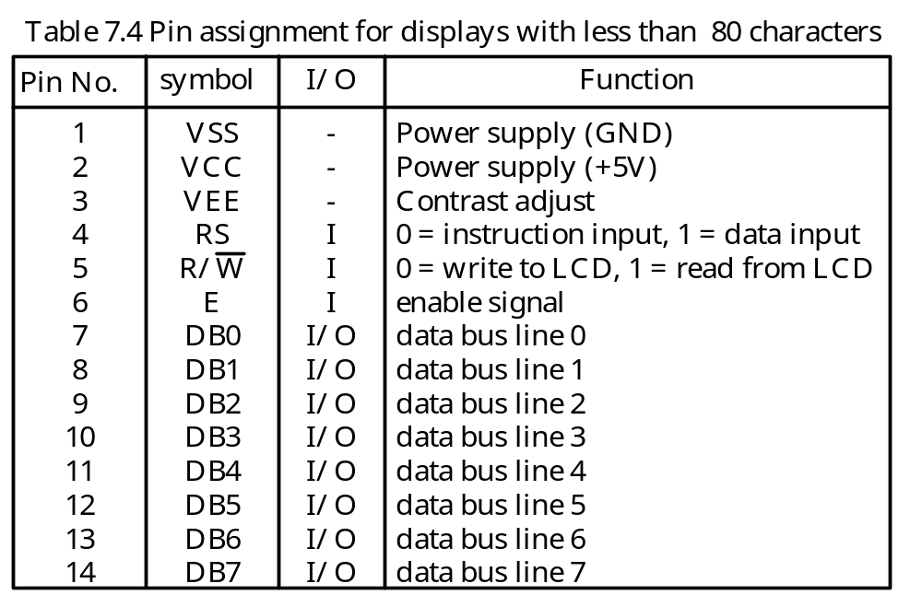
The DB7..DB0 pins are used to exchange data with the microcontroller.
The R/W pin determines the data transfer direction.
The E pin enables the data exchange with the LCD kit.
The HD44780 has an instruction register and a data register.
The RS signal selects the instruction register when it is low and selects the data register when it is 1.
The VEE signal is used to adjust the brightness of the LCD and is often connected to a potentiometer.

Slide 26
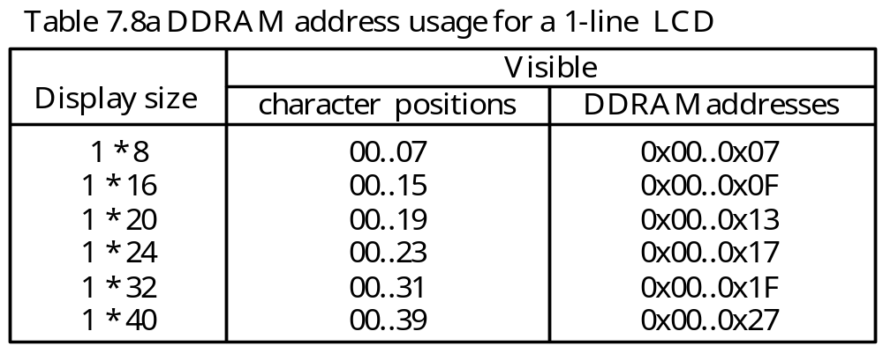
The HD44780 Controller
The HD44780 can be configured to control 1-line, 2-line, and 4-line displays.
The HD44780 controller has character generator ROM that can generate 208 5 × 8 dot characters and 32 5 × 10 dot characters.
Character generator RAM is available for defining 8 5 × 8 character patterns and 4
5 × 10 character patterns.
A set of instructions (Table 7.6) is available for users to configure the LCD operations.
The HD44780 controller has display data memory (DDRAM) to store the display data.
The address of a display data memory location determines where the next character will appear on the LCD screen.
The mapping from display data memory to the LCD screen position is not sequential and is shown in Table 7.8a, 7.8b, and 7.8c.

Slide 27
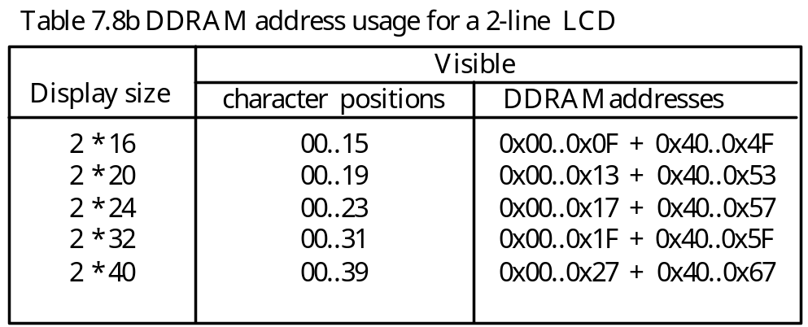
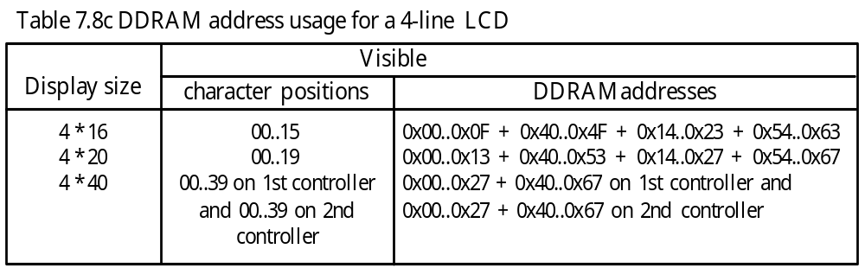

Slide 28
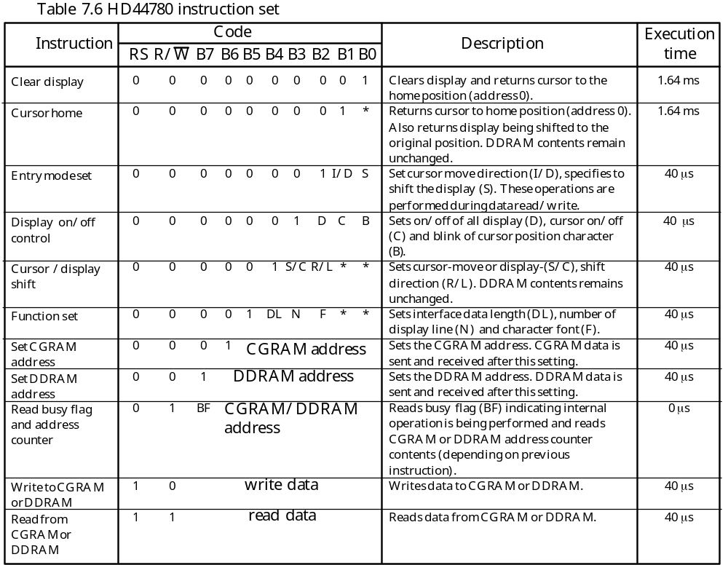

Slide 29
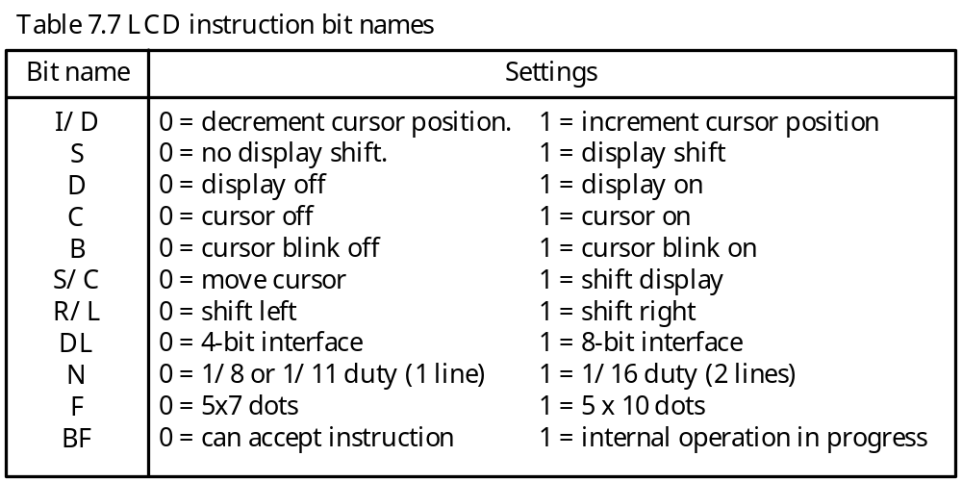
The IR Register
The microcontroller writes command (or instruction) into this register to configure
the LCD operation parameters.
- The LCD instruction set is listed in Table 7.6.

Slide 30
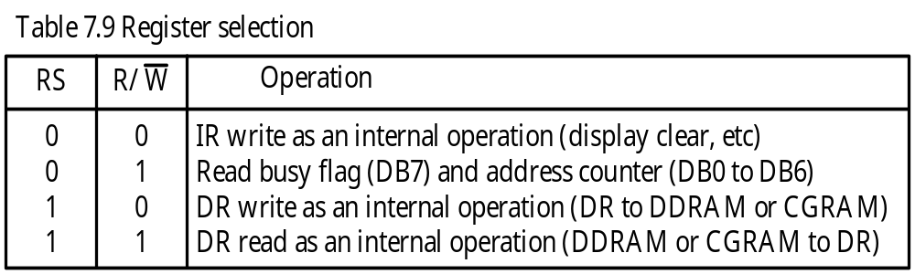
The DR Register
- The data to be written into the DDRAM or CGRAM is written into this register.
To read data from DDRAM or CGRAM, the microcontroller reads from this register.
Address Counter (AC)
This 7-bit address counter keeps track of the address of the next DDRAM or CGRAM location to be accessed.
The selection of DDRAM or CGRAM is determined by the instruction.
The content of this register is incremented after the access to DDRAM or CGRAM.
The register selection is shown in Table 7.9.

Slide 31
HD44780 Commands
1. Clear display (0x01). This command clears the LCD screen, sets the address counter to 0, sets the cursor to the upper left corner of the LCD screen, and also sets the I/D bit to 1 in entry mode.
2. Return Home (0x02). Sets DDRAM address 0 into address counter, move cursor to the upper left corner of the display but does not change the contents of the DDRAM.
3. Entry Mode Set. The I/D bit of this command controls the incrementing or decrementing of the DDRAM address. The display will shift if the S bit is 1 when the DDRAM is being written into.
4. Display On/Off Control. This command can turn on the display (D = 1), turn on the cursor (C = 1), and turn on the cursor blinking (B = 1).
5. Cursor or Display Shift. This command determines to shift the cursor (S/C = 0 bit) or display (S/C bit = 1) to the right (R/L bit = 1) or to the left (R/L bit = 0).

Slide 32
6. Function Set. This command allows the user to set the interface data length, select the number of lines, and the font size:
DL bit. When set to 1, data is exchanged in 8-bit length. Otherwise, data is exchanged in 4-bit length.
N bit. When set to 1, two-line display is selected. Otherwise, 1-line display is selected.
F bit. When set to 0, the 5 × 7 font is selected. Otherwise, 5 × 10 font is selected.
7. Set CGRAM Address. This command contains the CGRAM address to be set into the address counter.
8. Set DDRAM Address. This command allows to set the DDRAM address into the address counter.
9. Read Busy Flag and Address. This instruction reads the busy flag (BF) and the address counter. The BF flag indicates whether the LCD controller is still executing the previously received command.

Slide 33
Interfacing the HD44780 with the PIC18
There are two methods to interface the LCD kit to the PIC18.
The first method is treating the LCD kit as an I/O device. One of the available I/O port is used to connect to the DB7…DB0 pins. Other port pins are used to connect to the R/W, E, and S inputs of the LCD kit and generate the required timing sequence on these three pins.
The second method is to treat the LCD kit as a memory device and use the address decoder to generate a select signal to select the LCD kit. This method allows the user to use the table read and table write instructions to access the LCD kit.
The second method cannot be used by those PIC18 members that do not support the external memory.
Only the first method will be used to interface the LCD kit with the PIC18 in this text.
The circuit for the first approach is shown in Figure 7.21.

Slide 34
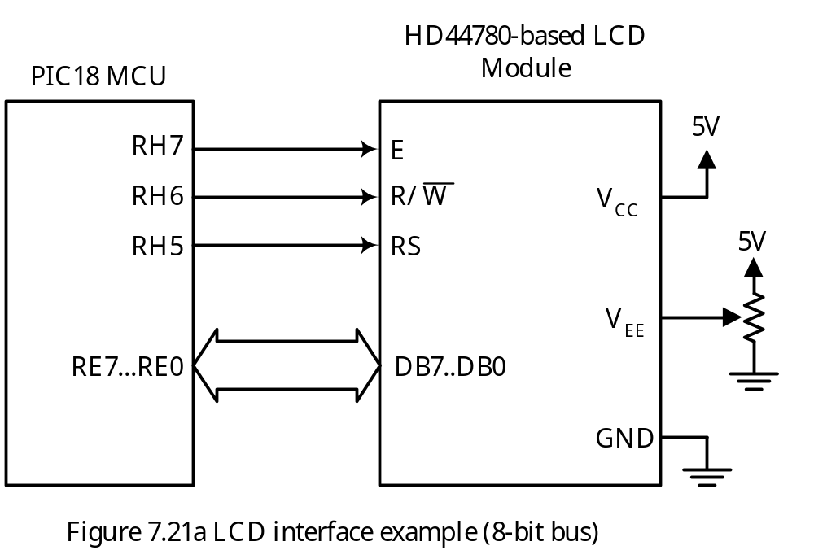

Slide 35
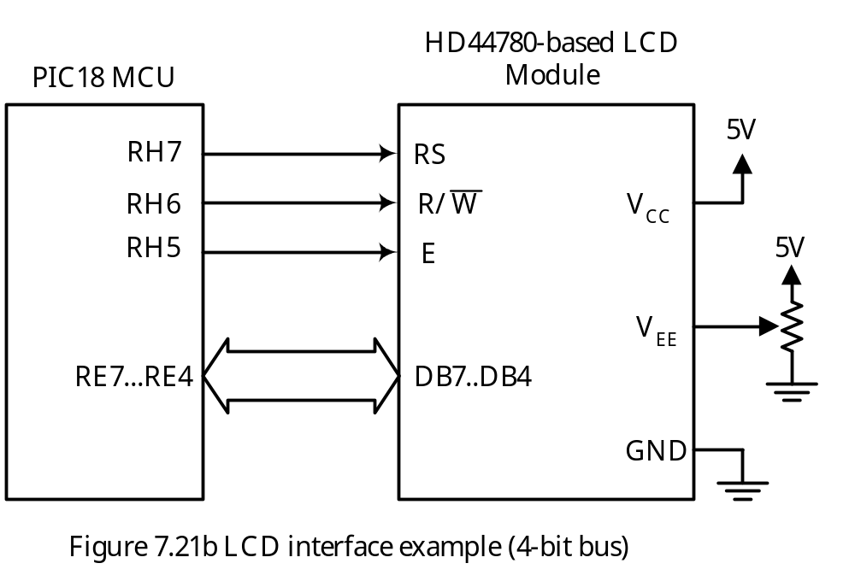

Slide 36
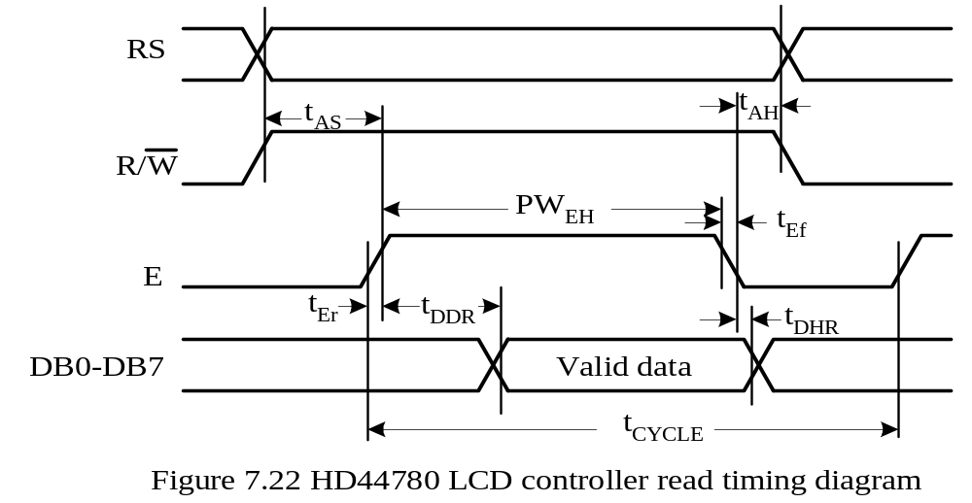
Timing Consideration for the LCD
- Certain timing parameters must be satisfied in order to successfully access the LCD.
The read and write timing diagrams are shown in Figure 7.22 and 7.23.
The HD44780 can operate at either 1 MHz or 2 MHz. The values of timing parameters for 2-MHz operation are shown in Table 7.12.

Slide 37
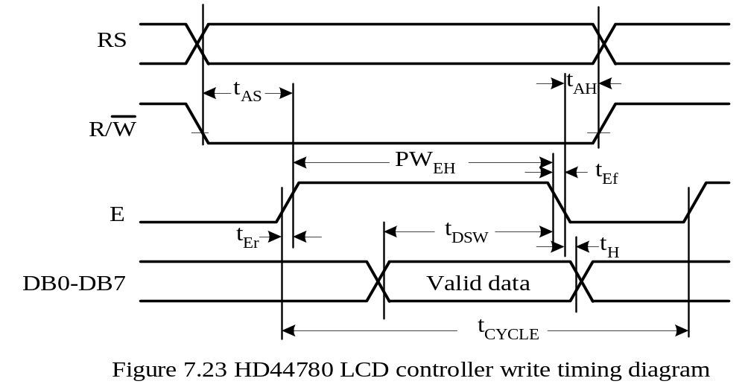
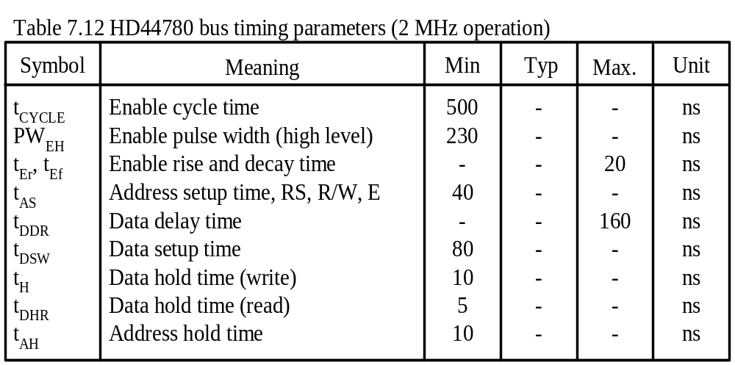

Slide 38
LCD Programming
To display messages on the LCD, the following subroutines are needed:
1. LCD_rdy: make sure the LCD is not busy with internal operation
2. init_lcd: configure the LCD operation parameters
3. LCD_cmd: send a command to the LCD
4. send2LCD: generate a timing sequence to output the contents of WREG to the LCD
5. LCD_putc: output the character in WREG to the LCD
6. LCD_putstr: output the string in program memory pointed to by TBLPTR to the LCD
7. LCD_putsr: output the string in data memory pointed to by FSR0 to the LCD
8. get_DDRAM_addr: reads the current DDRAM address and returns it in PRODL.

Slide 39
The following signals are defined to simplify the access of signals for the SSE8680 and SSE8720 demo boards:
LCD_DATA equ PORTE ; LCD data bus
#define LCD_D_DIR TRISE,A ; LCD data port direction
#define LCD_E PORTH,7,A ; LCD E clock
#define LCD_E_DIR TRISH,7,A ; LCD E clock direction
#define LCD_RW PORTH,6,A ; LCD read/write line
#define LCD_RW_DIR TRISH,6,A ; LCD R/W pin direction
#define LCD_RS PORTH,5,A ; LCD register select line
#define LCD_RS_DIR TRISH,5,A ; LCD RS signal direction
#define lcd_cport PORTH,A

Slide 40
Procedure for Writing a Byte into the IR register
Step 1
Pull the RS and the E signals to low.
Step 2
Pull the R/W signal to low.
Step 3
Pull the E signal to high.
Step 4
Output data to the output port attached to the LCD data bus. (Need to configure port E for output).
Step 5
Pull the E signal to low.

Slide 41
Procedure for Reading a Byte from the IR register
Step 1
Pull the RS and the E signals to low.
Step 2
Pull the R/W signal to high.
Step 3
Pull the E signal to high.
Step 4
Read the value of the LCD data bus. (need to configure port E for input)
Step 5
Pull the E signal to low.

Slide 42
Procedure for Writing a Byte into the LCD data register
Step 1
Pull the RS signal to high and pull the E signals to low.
Step 2
Pull the R/W signal to low.
Step 3
Pull the E signal to high.
Step 4
Output data to the I/O port attached to the LCD data bus.
Step 5
Pull the E signal to low.

Slide 43
; The following subroutines are written to work for f_{OSC} up to 32 MHz.
LCD_rdy setf LCD_D_DIR ; configure LCD data port for input
bcf LCD_RS ; select IR register
bsf LCD_RW ; setup to read busy flag
bsf LCD_E ; pull LCD E-line to high
nop ; small delay
movf LCD_DATA,W,A ; read busy flag and DDRAM address
nop ; small delay to lengthen E pulse
bcf LCD_E ; pull LCD E-line to low
btfsc WREG,7,A ; is busy flag (BF) cleared
goto LCD_rdy
clrf LCD_D_DIR ; configure data pins for output
return

Slide 44
LCD_cmd pushr WREG ; save WREG in the stack
call LCD_rdy ; wait until LCD is ready
bcf LCD_RS ; select IR register
bcf LCD_RW ; Set write mode
bsf LCD_E ; Setup to clock data
popr WREG ; restore WREG
movwf LCD_DATA,A ; send out the command in WREG
nop ; small delay to lengthen E pulse
bcf LCD_E
return
A common LCD configuration for a 2x20 LCD is as follows:
Set the LCD to 2-line display
Turn on display, cursor, and blinking
Shift cursor right
Clear the display and return the cursor to home position

Slide 45
LCD_init clrf LCD_ctl_port ; make sure the LCD control port is low
bcf LCD_E_DIR ; configure control lines
bcf LCD_RW_DIR ; directions to output
bcf LCD_RS_DIR ; "
movlw 0x3C ; configure display to 2 x 20
call LCD_cmd ; send command to LCD
movlw 0x0F ; turn on display and cursor
call LCD_cmd ; "
movlw 0x14 ; shift cursor right
call LCD_cmd ; "
movlw 0x01 ; clear cursor and return to home position
call LCD_cmd ; "
return

Slide 46
get_DDRAM_addr
setf LCD_D_DIR ; configure LCD data port for input
bcf LCD_RS ; select IR register
bsf LCD_RW ; setup to read busy flag
bsf LCD_E ; pull LCD E-line to high
nop ; add a small delay
movf LCD_DATA,W ; read busy flag and DDRAM address
nop ; small delay to length E pulse
bcf LCD_E ; pull LCD E-line to low
movwf PRODL,A
return
send2LCD ; this subroutine writes WREG to LCD
bsf LCD_RS ; select DR register
bcf LCD_RW ; Set write mode
bsf LCD_E ; Setup to clock data
nop
movwf LCD_DATA,A ; write into LCD DR
nop ; a short delay
bcf LCD_E
return

Slide 47
Output a Character to a 2x20 or a 4x20 LCD
One needs to check if the address counter points to the end of a row.
To find out if the address counter is at the end of a row, one needs to read the DDRAM address.
The character that is output to the end of a row cannot be displayed and must be resent to the beginning of the next row.
LCD_putc pushr WREG ; save WREG
call LCD_rdy ; wait until LCD is not busy
popr WREG ; restore data in WREG
call send2LCD ; write WREG content to LCD
pushr WREG ; save WREG data
call get_DDRAM_addr ; get the DDRAM address in PRODL
movlw 0x13
cpfseq PRODL,A
goto chk_0x53
; reach the end of first line
movlw 0xC0
call LCD_cmd ; set DDRAM address to 0x40
call LCD_rdy
popr WREG
call send2LCD ; re-output the same character
return

Slide 48
chk_0x53 movlw 0x53
cpfseq PRODL,A
goto chk_0x27
; reach the end of the second line
movlw 0x94 ; set DDRAM address to 0x14 (start of
call LCD_cmd ; 3rd row)
call LCD_rdy
popr WREG
call send2LCD
return
; reach the end of the third line
chk_0x27 movlw 0x27
cpfseq PRODL,A
return
movlw 0xD4 ; set DDRAM address to 0x54 (start of
call LCD_cmd ; 4th row)
call LCD_rdy
popr WREG
call send2LCD
return

Slide 49
; output a string (pointed to by TBLPTR) in program memory to the LCD
LCD_putstr tblrd*+ ; read a character into TABLAT
movf TABLAT,W,A ; copy to WREG
tstfsz WREG,A ; test WREG and skip if zero
goto send_it
return
send_it call LCD_putc
goto LCD_putstr
; output a string (pointed to by FSR0) in data memory to the LCD
LCD_putsr movf POSTINC0,W ; read a byte to WREG
tstfsz WREG,A ; test WREG and skip if zero
goto send_it
return
send_it call LCD_putc
goto LCD_putsr

Slide 50
In C language,
#define LCD_DATA PORTE
#define LCD_D_DIR TRISE
#define LCD_RS PORTHbits.RH5
#define LCD_RS_DIR TRISHbits.TRISH5
#define LCD_RW PORTHbits.RH6
#define LCD_RW_DIR TRISHbits.TRISH6
#define LCD_E PORTHbits.RH7
#define LCD_E_DIR TRISHbits.TRISH7
/* These are function prototype definitions */
void LCD_rdy(void);
void LCD_cmd(char cx);
void LCD_init(void);
char get_DDRAM_addr(void);
void LCD_putc (char dx);
void LCD_putstr(rom char *ptr);
void LCD_putsr(char *ptr);
void send2LCD(char xy);

Slide 51
/******************************************************************/
/* the following function waits until the LCD is not busy. */
/******************************************************************/
void LCD_rdy(void)
{
char test;
LCD_D_DIR = 0xFF; /* configure LCD data bus for input */
test = 0x80;
while (test) {
LCD_RS = 0; /* select IR register */
LCD_RW = 1; /* Set read mode */
LCD_E = 1; /* Setup to clock data */
test = LCD_DATA;
Nop();
LCD_E = 0; /* complete a read cycle */
test &= 0x80; /* check bit 7 */
}
LCD_D_DIR = 0x00; /* configure LCD data bus for output */
}

Slide 52
/******************************************************************/
/* The following function sends a command to the LCD. */
/******************************************************************/
void LCD_cmd(char cx)
{
LCD_rdy(); /* wait until LCD is ready */
LCD_RS = 0; /* select IR register */
LCD_RW = 0; /* Set write mode */
LCD_E = 1; /* Setup to clock data */
Nop();
LCD_DATA = cx; /* send out the command */
Nop(); /* small delay to lengthen E pulse */
LCD_E = 0; /* complete an external write cycle */
}

Slide 53
/*******************************************************************/
/* The following function initializes the LCD kit properly. */
/*******************************************************************/
void LCD_init(void)
{
PORTH = 0; /* make sure LCD control port is low */
LCD_E_DIR = 0; /* configure LCD control port for output */
LCD_RS_DIR = 0; /* “ */
LCD_RW_DIR = 0; /* “ */
LCD_cmd(0x3C); /* configure display to 2 rows */
LCD_cmd(0x0F); /* turn on display, cursor, and blinking */
LCD_cmd(0x14); /* shift cursor right */
LCD_cmd(0x01); /* clear display and move cursor to home */
}

Slide 54
/*******************************************************************/
/* The following function obtains the LCD cursor address. */
/*******************************************************************/
char get_DDRAM_addr (void)
{
char temp;
LCD_D_DIR = 0xFF; /* configure LCD data port for input */
LCD_RS = 0; /* select IR register */
LCD_RW = 1; /* setup to read busy flag */
LCD_E = 1; /* pull LCD E-line to high */
Nop(); /* small delay */
temp = LCD_DATA & 0x7F; /* read DDRAM address */
Nop(); /* small delay to length E pulse */
LCD_E = 0; /* pull LCD E-line to low */
return temp;
}

Slide 55
/*********************************************************************/
/* The following function sends a character to the LCD kit. */
/*********************************************************************/
void LCD_putc (char dx)
{
char addr;
LCD_rdy(); /* wait until LCD internal operation is complete */
send2LCD(dx);
LCD_rdy(); /* wait until LCD internal operation is complete */
addr = get_DDRAM_addr();
if (addr == 0x13) {
LCD_cmd(0xC0); /* set address to 0x40 (1st column of the 2nd row) */
LCD_rdy();
send2LCD(dx);
}
else if(addr == 0x53) {
LCD_cmd(0x94); /* set address to 0x14 (1st column of the 3rd row) */
LCD_rdy();
send2LCD(dx);
}

Slide 56
else if(addr == 0x27){
LCD_cmd(0xD4); /* set address to 0x54 (1st column of the 4th row) */
LCD_rdy();
send2LCD(dx);
}
}
/**************************************************************/
/* The following function outputs a string to the LCD. */
/**************************************************************/
void LCD_putstr(rom char *ptr)
{
while (*ptr) {
LCD_putc (*ptr);
ptr++;
}
}

Slide 57
/**************************************************************/
/* The following function outputs a string to the LCD. */
/**************************************************************/
void LCD_putsr(char *ptr)
{
while (*ptr) {
LCD_putc (*ptr);
ptr++;
}
}
/****************************************************************/
/* The following function writes a character to the LCD. */
/****************************************************************/
void send2LCD(char xy)
{
LCD_RS = 1;
LCD_RW = 0;
LCD_E = 1;
LCD_DATA = xy;
Nop();
Nop();
LCD_E = 0;
}

Slide 58
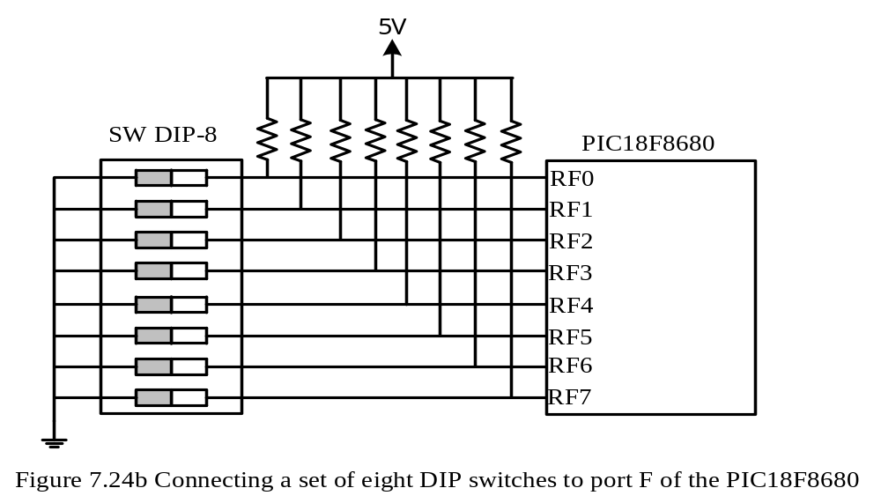
Interfacing with DIP Switches
Reading a byte from the DIP switches to WREG
movlw 0xFF ; configure port F for input
movwf TRISF ; “
movf PORTF,W ; read portF

Slide 59
Interfacing with Keypad
Types of Key Switches
1. Membrane: A plastic or rubber membrane presses one conductor onto another.
This type of switches can be made very small.
2. Capacitive: Two parallel plates. Pressing the plates changes the distance between the plates and changes the capacitance.
3. Hall effect: The motion of the magnetic flux lines of a permanent magnet perpendicular to a crystal is detected as voltage appearing between the two faces of the crystal
4. Mechanical: Two metal contacts are brought together to complete an electrical circuit
Mechanical Keypads and Keyboard
Low cost and strength of construction
Most popular
Pressing the key switch generates a series of pulses instead of a single clean output
Human being cannot press and release the key switch 20 ms
A debouncing process is required for correct operation

Slide 60
Keypad Input Program Consists of Three Parts
1. Keypad scanning
2. Key switch debouncing
3. Table lookup
Keypad Scanning
Performed to detect which key is being pressed
Performed row by row and column by column
The rows and columns of a keypad are simply conductors
A simple keypad is shown in Figure 7.26b.
The row to be scanned is pulled to low. Other rows are pulled high.
When a key is pressed, the corresponding row and column are shorted together and is detected low.
The diodes in Figure 7.26b provides protection of accidental simultaneous press of multiple keys.

Slide 61
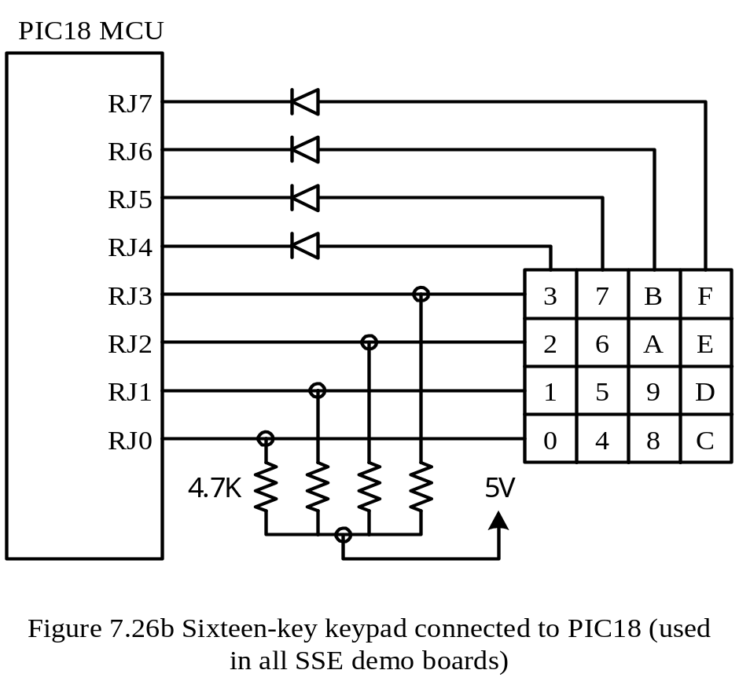

Slide 62
Keypad Debouncing
When a key is pressed, the voltage of the key switch falls and rises a few times within a period of about 5 ms as a contact bounces.
A debouncer will recognize that the switch is closed after the voltage is low for about 10 ms and will recognize that the switch is open after the voltage is high for about 10 ms.
Both hardware and software debouncing solutions are available.
The simplest and most popular software solution is wait-and-see. The program simply waits for 10 ms after detecting a key switch is closed and re-examines the same key.
Three hardware debouncing techniques are shown in Figure 7.27.
ASCII Code Lookup
The keypad input subroutine returns the ASCII code to the caller.
This step can be embedded in the debouncing procedure.

Slide 63
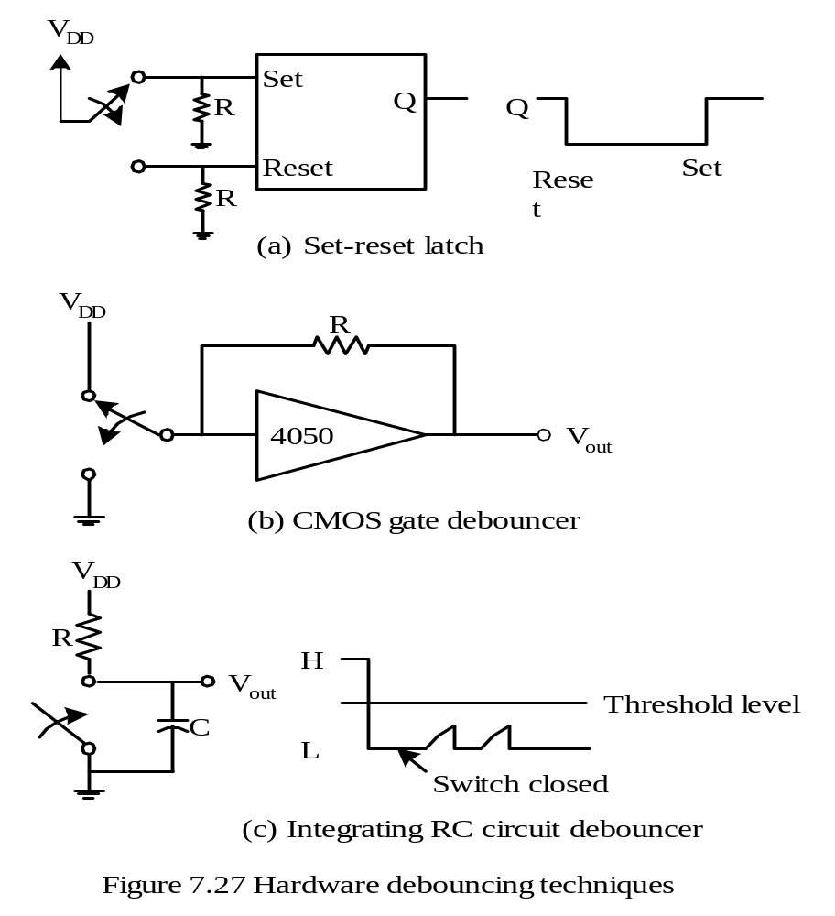

Slide 64
Example 7.10 Write a program to perform keypad scanning, debouncing, and returns the ASCII code of the pressed key to the caller.
Solution:
The instruction sequence for the first row is as follows:
keypad_dir equ TRISJ ; keypad direction control register
keypad equ PORTJ ; keypad port
get_key movlw 0x0F ; configure the upper four pins of keypad
movwf keypad_dir,A ; port for output, others for input
movlw 0xF0 ; set all keypad rows to high
iorwf keypad,F ; “
scan_r0 movlw 0xEF
andwf keypad,F,A ; prepare to scan row 0 (driven by RB4)
scan_k0 btfss keypad,0,A ; check key 0
goto db_key0
scan_k1 btfss keypad,1,A ; check key 1
goto db_key1
scan_k2 btfss keypad,2,A ; check key 2
goto db_key2
scan_k3 btfss keypad,3,A ; check key 3
goto db_key3
…

Slide 65
db_key0 call wait10ms ; wait for 10 ms
btfsc keypad,0,A ; is key 0 still closed?
goto scan_k1 ; key 0 not pressed, check key 1
movlw 0x30
return
db_key1 call wait10ms
btfsc keypad,1,A ; is key 1 still closed?
goto scan_k2
movlw 0x31
return
db_key2 call wait10ms
btfsc keypad,2,A ; is key 2 still closed?
goto scan_k3
movlw 0x32
return
db_key3 call wait10ms
btfsc keypad,3,A
goto scan_r1
movlw 0x33
return
…

Slide 66
; *******************************************************************
; This subroutine creates a 10 ms delay using timer 0 with f_{OSC} = 32 MHz.
; *******************************************************************
wait10ms bcf INTCON,INT0IE,A ; disable TMR0 interrupt
bcf INTCON,INT0IF,A ; clear TMR0IF flag
movlw 0x03 ; configure TMR0 with 1:16 prescaler
movwf T0CON,A ; configure TMR0
movlw 0x3C
movwf TMR0H,A
movlw 0xBB
movwf TMR0L,A ; load (50000 - 12) into TMR0
bsf T0CON,TMR0ON,A ; enable TMR0
dlyloop btfss INTCON,INT0IF,A ; is 10 ms over yet?
goto dlyloop
return
end
The C language version is in the following slides:

Slide 67
#include <p18F8680.h>
#define keypad_dir TRISJ
#define keypad PORTJ
void wait_10ms(void);
…
unsigned char get_key (void)
{
keypad_dir = 0x0F; /* configure RJ7..RJ4 for output */
keypad |= 0xF0; /* RJ3..RJ0 for input */
while (1) {
keypad &= 0xEF; /* set RJ4 to low to scan the first row */
if (!(keypadbits.RB0)) {
wait_10ms( );
if (!(keypadbits.RB0))
return 0x30; /* return the ASCII code of 0 */
}
if (!(keypadbits.RB1)) {
wait_10ms( );
if (!(keypadbits.RB1))
return 0x31; /* return the ASCII code of 1 */
…
}

Slide 68
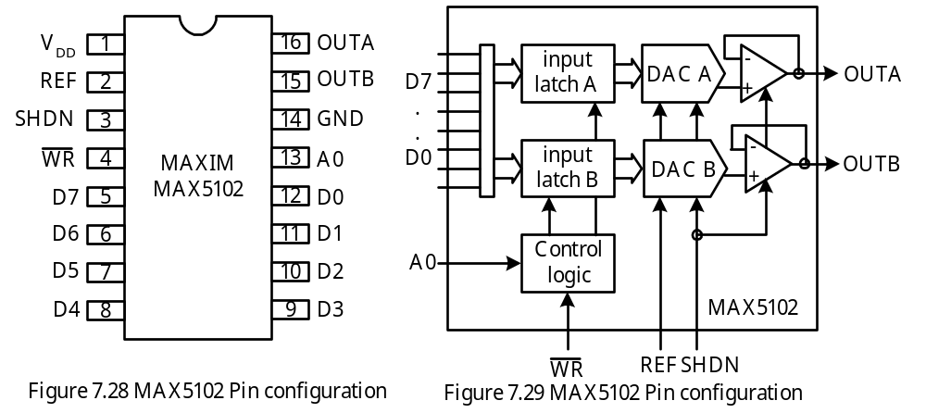
The MAX5102 DAC
Dual-channel, 8-bit DAC made by Maxim
Block diagram and pin assignment are shown in Figure 7.28 and 7.29.

Slide 69
Pin Functions
OUTA, OUTB: analog voltage output.
D7..D0: data inputs. Digital code to be converted is sent to MX5102 over these eight pins.
REF: Reference voltage input. This signal controls the magnitude of OUTA and OUTB.
WR: Write. When this signal is low, new digital code can be written into the MAX5102.
A0: DAC address select bit. DAC address select bit. Channel A is selected when A0 = 0.
VDD: Positive supply voltage. The range of VDD is from 5V to 15V.
GND: Ground.
SHDN: Shutdown. When set to high, this signal shuts down the chip to save power.
Voltage Output
V_{OUT} = (NB × V_{REF}) ÷ 256
where, NB is the digital input to be converted
V_{REF} is the reference voltage

Slide 70
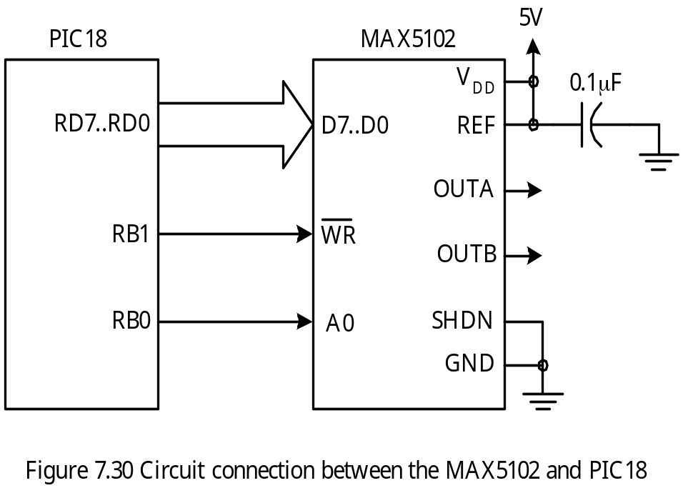
Functioning of the MAX5102 DAC
To write new data to be converted, the WR input must be low.
Data input is latched on the rising edge of the WR signal.
After WR goes high, the data input can change without affecting V_{OUT}.
Circuit connection with the PIC18 is shown in Figure 7.31.

Slide 71
Example 7.11 Write a program to generate a 1KHz square wave from OUTA pin
assuming the instruction cycle time is 200 ns (correspond to 20 MHz crystal oscillator).
Solution: The procedure is as follows:
Step 1
Configure the pins RD7..RD0, RB1..RB0 for output.
Step 2
Clear the RB0 pin to low to select OUTA channel.
Step 3
Pull the RB1 pin to low.
Step 4
Output 255 to Port D.
Step 5
Pull the RB1 pin to high.
Step 6
Wait for 0.5 ms.
Step 7
Pull the RB1 pin to low.
Step 8
Output 0 to Port D.
Step 9
Pull the RB1 pin to high.

Slide 72
Step 10
Wait for 0.5 ms.
Step 11
Go to Step 3.
The C program to generate the waveform is as follows:
#define DAC_data PORTD /* DAC data port */
#define DAC_dat_dir TRISD /* DAC data bus direction register */
#define DAC_ctl_dir TRISB /* DAC control pins direction */
#define DAC_WR PORTBbits.RB1 /* DAC write control pin */
#define DAC_A0 PORTBbits.RB0 /* DAC A0 pin */
#define output 0x00
#define high 1
#define low 0
void main (void)
{
DAC_dat_dir = output; /* configure DAC data bus direction to output */
DAC_ctl_dir &= 0xFC; /* configure WR & A0 pins for output */
DAC_A0 = 0; /* select OUTA channel */

Slide 73
while (1) {
DAC_WR = low;
DAC_data = 255; /* output a high voltage */
DAC_WR = high;
Delay100TCYx(25); /* wait for 0.5 ms */
DAC_WR = low;
DAC_data = 0; /* output a low voltage */
DAC_WR = high;
Delay100TCYx(25); /* wait for 0.5 ms */
}
}

